Slide 1
Budgetary Affairs Committee Report
Faculty Senate Meeting
December 7, 2017

Slide 2
FY17 / FY18 Projection Budget Summaries (More details are in
the October 19th BAC report.)
2 . Summary of Retention Efforts

Slide 3
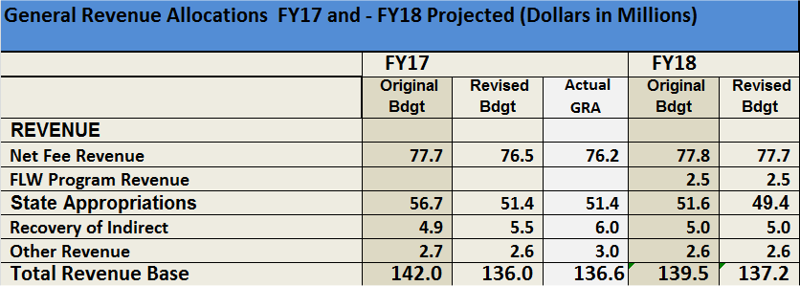
* Cuba Plain and Lisa Cerney, October 19, 2017

Slide 4
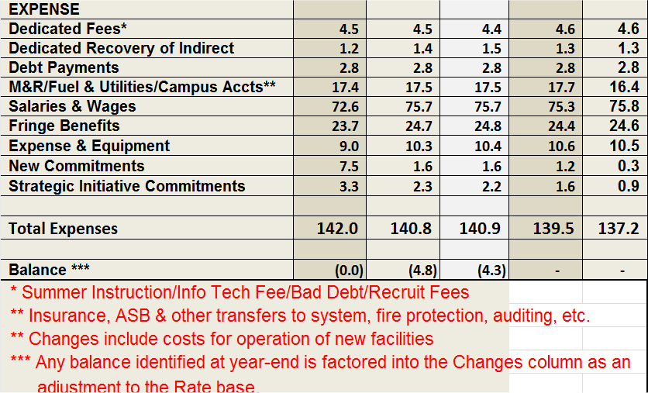
* Cuba Plain and Lisa Cerney, October 19, 2017

Slide 5
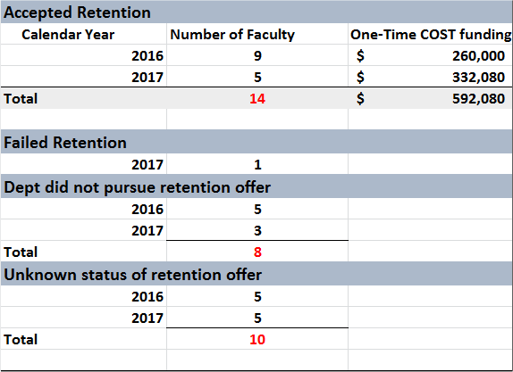
SUMMARY OF FY16-FY17 FACULTY RETENTION EFFORTS
* Cuba Plain and Lisa Cerney, December 6, 2017

